Slide 1

CFBH Progress Report
May 10, 2021

Slide 2




Agenda

Slide 3
Foundation Identity
Vision
Mission
Values

Slide 4

Vision
To be an international leader in advancing behavioral healthcare through Research, Education, and Service.
Notes:
[[ This slide uses only icons, which are more lightweight for the processor and hence will animate quicker and smoother. Feedback on preference regarding performance vs visual design is appreciated. ]]
Our focus is on Behavioral Healthcare
We seek to be internationally recognized
And…

Slide 5
Vision
Research
Education
Service
Notes:
Research, Education, and Service are the three core pillars to our vision.

Slide 6



Mission
Create a world where everyone has access to proven and effective behavioral healthcare, allowing them to realize their full potential.
Notes:
This is what differentiates us from competitors with similar visions:
Our mission is to provide behavioral healthcare that is proven and effective
We seek to help people realize their full potential, which is only possible with well-rounded healthcare, of which behavioral healthcare is a key component

Slide 7





Values
Embrace Change and Growth
Learn Continuously
Act with Integrity
Prioritize Collaboration
Commit Fully
Our goals are best accomplished by being open to new ideas. To this end, we seek out opportunities to broaden our knowledge and experiences. We reexamine our preconceptions and biases.
Innovation is not a passive pursuit done in isolation. We make every effort to integrate the feedback we receive into our work, and openly share our insights to inspire others.
What we say is what we do. We align our words and our actions, and thus engender trust. Knowing that good failures are integral to experimentation, we own our successes as well as our mistakes.
We don’t have all the answers. By recognizing, welcoming and valuing the strengths of all stakeholders, we build lasting relationships and grow stronger together.
Meaningful change takes time, effort and dedication. We take on challenges with a clarity of focus and an unwavering resilience.
Notes:
These help keep us on the right track when pursuing our mission and realizing our vision.

Slide 8
ACPD Program Overview
Vision
Progress
Plans

Slide 9
Program Vision
Connect emergency responders with the resources they need to manage their behavioral health.
How best do you build and run a behavioral wellness program for emergency responders?
Inform the public and emergency responders on how best to manage behavioral health.
Research
Education
Service

Slide 10

Program Progress
Sep. 2020
Identification of behavioral wellness project with police officers.
Initiation of literature review by COR
Oct. 2020
Project approved by CFBH Board
Identification of ACPD as project site
Nov. 2020
Completion of literature review
Meetings with ACPD
Dec. 2020
ACPD willing to serve as demonstration site
COR to conduct needs assessment
Jan. 2021
COR interviews with ACPD
Ongoing conversations with ACPD and potential partners
Feb. 2021
COR completes design of Needs Assessment Survey
Meetings with ACPD to outline MOU
Notes:
Comments on completed goals and progress

Slide 11
Program Plans
May. 2021
Complete project approvals
June. 2021
Identify behavioral wellness program objectives
July. 2021
Create initial program evaluation tool
Launch behavioral wellness program
Launch Needs Assessment
Complete Needs Assessment and report
Identify program components
Identify measurable indicators of behavioral wellness
50%
50%
80%
Notes:
Comments on completed goals and progress

Slide 12
Program Plan
Develop Wellness Program Criteria
Conduct Department Wellness Needs Assessment
Develop Department Wellness Objective
Evaluate
Wellness
Program
Construct Complete
Wellness Program
Select/Design Wellness Program Interventions
Notes:
Conduct Department Wellness Needs Assessment
Comments, progress, etc.
Develop Department Wellness Objective
Comments, progress, etc.
Develop Wellness Program Criteria
Comments, progress, etc.
Select/Design Wellness Program Interventions
Comments, progress, etc.
Construct Complete Wellness Program
Comments, progress, etc.
Evaluate Wellness Program
Comments, progress, etc.

Slide 13
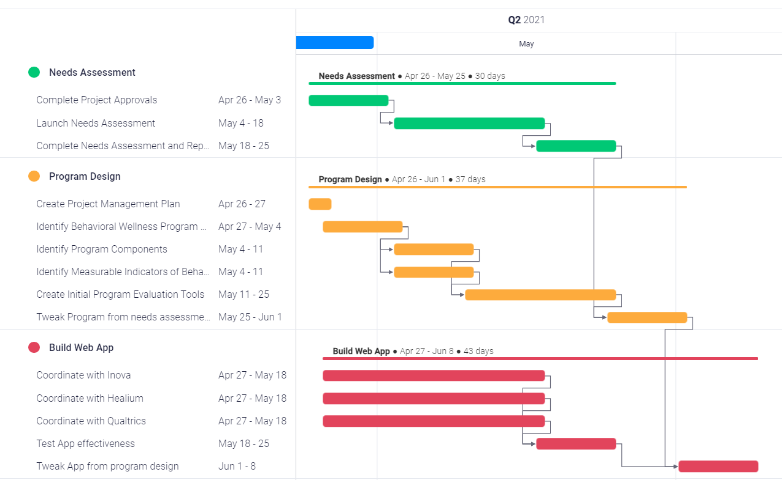
Notes:
Needs Assessment
- There is a hold up in getting project approvals; needs assessment can launch immediately on approval (estimated date of launch: ????)
- Background work for needs assessment is complete (questions prepared for Qualtrics, research team ready to go)
- Additional comments, progress, etc.
Program Design
- Main program components have been identified; will likely only need minor tweaking in response to needs assessment results
- Additional comments, progress, etc.
Web Application Development
Comments, progress, etc.

Slide 14
Projected Plan Dates:
March April May
Complete Project Approvals
Launch Needs Assessment
Complete Needs Assessment and Report
Identify Behavioral Wellness Program Objectives
Identify Program Components
Identify Measurable Indicators of Behavioral Wellness
Create Initial Program Evaluation Tools
Launch Behavioral Wellness Program

Slide 15
ACPD Program Preview
Service
Research

Slide 16
PREVIEW:
ACPD Behavioral Wellness Program
Menu / Resources
1. Fitness / Nutrition / Medical Wellness
‘
‘
‘
‘
Mental Health & Wellness
‘
‘
‘
‘
Professional Services
‘
‘
‘
‘

Slide 17




Service lines

Slide 18




Physical health services
Onsite Gym
Group Classes
Personal Training
Yoga
Onsite Health Coaching**
Exercise
Nutrition
Onsite Health Coaching**
Sleep Hygiene App**
Onsite Biometric Screening**
Sleep Hygiene
Body markers
Notes:
Exercise – Regular physical activity is known as a preventative measure for physical
and behavioral illness. Physical fitness is a major component of officer safety and
performance.
Onsite Gym
Group Classes
Personal Training
Yoga
Nutrition – Nutrition is the foundation for a healthy lifestyle and avoidance of many
medical issues including heart disease and cancer. Healthy eating assists in the
maintenance of healthy bodyweight which supports good sleep.
Onsite Health Coaching**
Sleep Hygiene – Sleep is critical to physical and mental recovery. Healthy sleep
patterns reduce physical and mental stress, enhance work performance and prevent
cognitive decline.
Onsite Health Coaching**
Sleep Hygiene App**
Body Markers – “Knowing your numbers” (Blood Pressure, BMI, Blood Lipid Levels,
Glucose and Bodyweight) is a key part of staying healthy and heading off health issues.
Onsite Biometric Screening**

Slide 19




Mental health services
Resilience Training **
Mindfulness Training**
In-House Peer Support
In-House Chaplain
Family Events
Behavioral Heath Apps
Equine Program**
Service Dogs
Education and Training
Support Services
On-site clinician
Insurance Plan Provided Psychological and Psychiatric Services
Residential Treatment
Substance Abuse Programs
Employee Assistance Program
Hotlines
Veterans Services
Professional Services
Referral Services
Notes:
Education and Training- Understanding and identifying the mental health challenges
inherent to policing is an important part of job safety and satisfaction.
Information and data on mental health issues impacting police officers
Resilience Training **
Mindfulness Training**
Support Services- There are many activities and services that are readily available to
support officer wellness.
In-House Peer Support
In-House Chaplain
Family Events
Behavioral Heath Apps
Equine Program**
Service Dogs
Professional Services and Programs- Officers are encouraged and supported in
seeking professional mental health services that will enhance their well-being.
On-site clinician
Insurance Plan Provided Psychological and Psychiatric Services
Residential Treatment
Substance Abuse Programs
Referral Services – In addition to the services and programs available through the
HCPD, referrals are provided that increase and enhance access behavioral health
resources.
Employee Assistance Program
Hotlines
Veterans Services

Slide 20
Web Presence
Goals
Progress
Plans

Slide 21
Site map progress
•Home Page•Our Mission Section•We Believe Section•Who We Are•General Information•History - "Our Story" Page•Founder Page•Origins Page•Leadership Page•Contact Us Page•What We Do•Continuing Education•Cummings Graduate Institute Page•Historical Preservation•Cummings Center for the History of Psychology Page•Terms and Conditions Page•404 Page

Slide 22

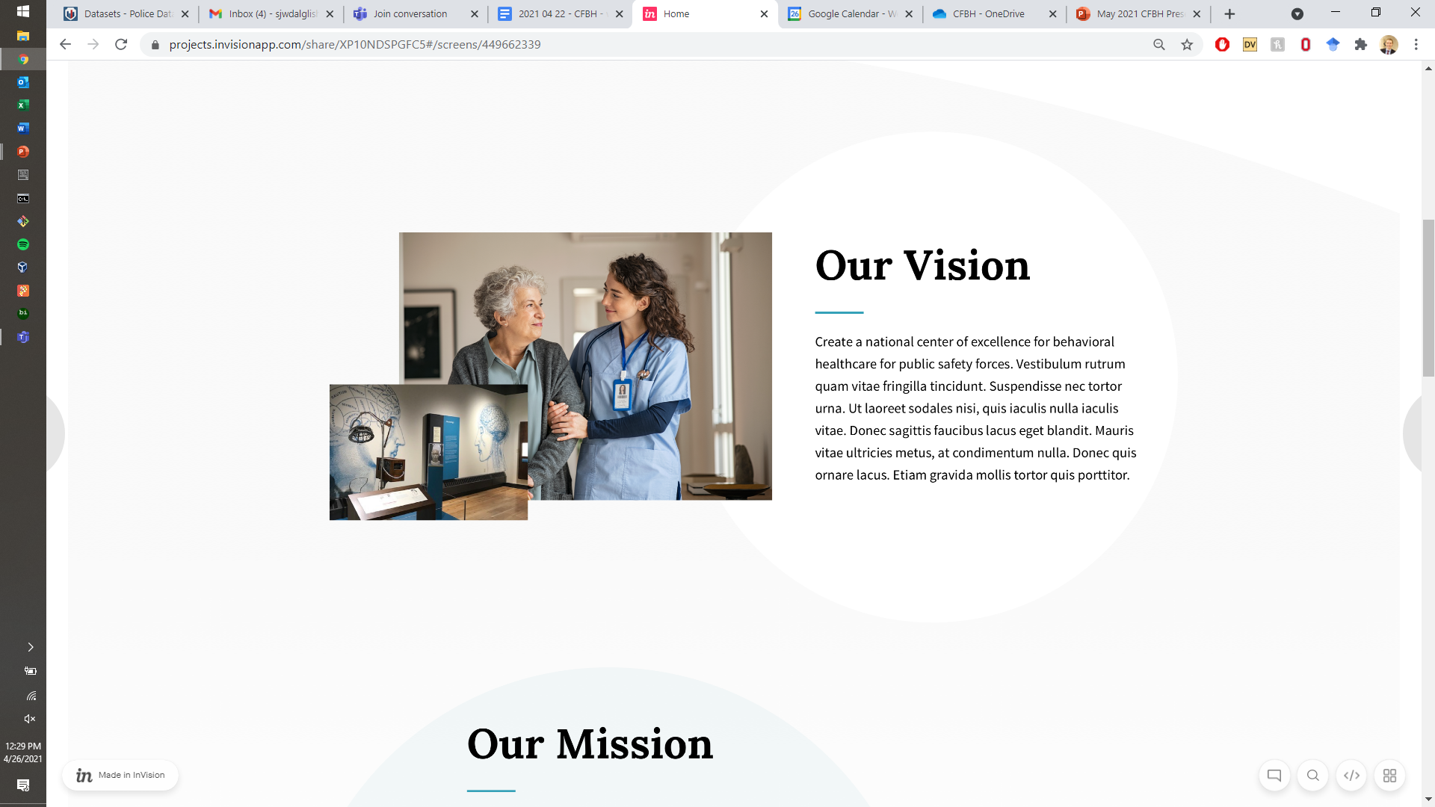
Landing page sample sections
View in Browser

Slide 23

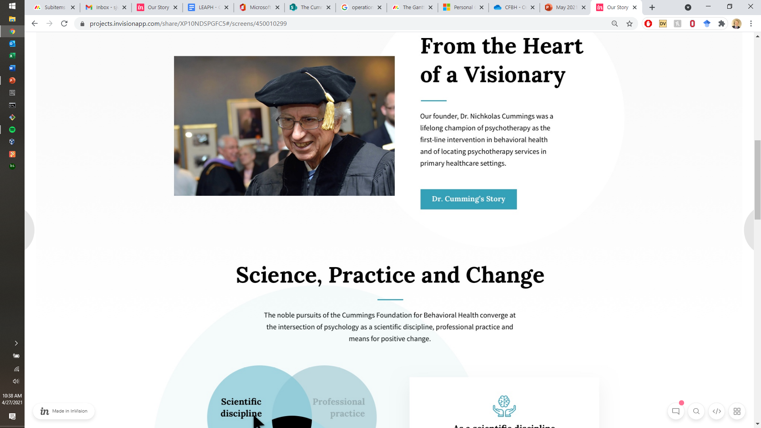
“Our Story” sample sections
View in Browser

Slide 24

Summary and Questions

